Slide 1
Type Checking

Slide 2
Introduction
A compiler must check that the source program follows both the syntactic and semantic conventions of the source language.
This checking, called static checking, ensures that certain kinds of programming errors will be detected and reported.
The static checks includes:
Type checks.
Flow-of-control check.
Uniqueness checks.
Name-related checks.

Slide 3
Static Checking
Decorated Abstract Syntax Tree
Intermediate Code Generator
Token
Stream
Abstract Syntax Tree
Static Checker
Intermediate Code
Parser
Static (Semantic) Checks
  Type checks: operator applied to incompatible operands?
  Flow of control checks: break (outside while?)
  Uniqueness checks: labels in case statements
  Name related checks: same name?

Slide 4
Variants of Syntax tree
Nodes I syntax tree represent constructs in the source program, children of a node represent components of a construct.
Abstract Syntax Trees (AST) – retain essential structure of the parse tree, eliminating unneeded nodes.
Directed Acyclic Graphs (DAG) – compacted AST to avoid duplication – smaller footprint as well

Slide 5
Directed Acyclic Graphs for Expressions
a + a * ( b – c ) + ( b – c ) * d
+
+
*
*
d
a
-
b
c

Slide 6
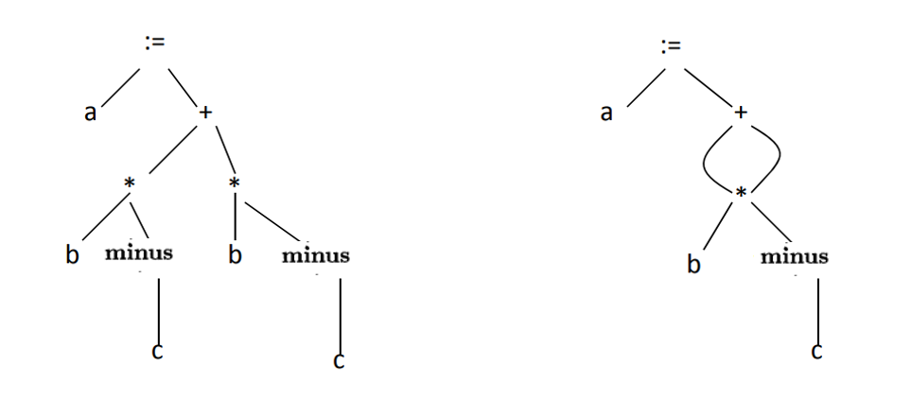
ASTs and DAGs: a := b *‐c + b*‐c

Slide 7
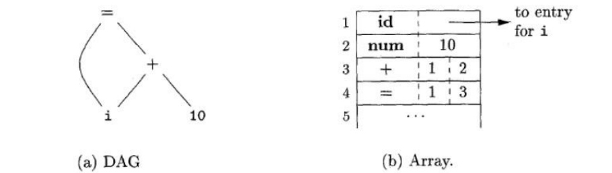
Value-number method for constructing DAG’s
Nodes of a syntax tree or DAG are stored in an array of records.
Each row = one record,
  1st field = operation code
  Leaves have additional field for lexical values
  Non-leaf nodes have 2 field for left and right children
Each node is indexed by an integer value called value number

Slide 8
Language Constructs
Is a syntactically allowable part of a program that may be formed from one or more lexical tokens in accordance with the rules of programming language.
printf(“Hello World”)

Slide 9
Static Checking
We inter information about a name into a symbol table, we can check that the name is declared uniquely.
A type checker verifies that the type of a construct matches that expected by its context.
Examples:
  mod requires integer operands (PASCAL)
  * (dereferencing) – applied to a pointer
  a[i] – indexing applied to an array
  f(a1, a2, …, an) – function applied to correct arguments.
Information gathered by a type checker needed during code generation

Slide 10
Type Systems
The design of a type checker for a language is based on information about:
  The syntactic constructs in the language.
  The notion of types.
  The rules for assigning types to the language constructs.
Examples: If both operators of “+”, “-”, “*” are of type integer then so is the result.
The result of the unary “&” operator is a pointer to the object referred to by the operand. If the type of the operand is ‘…….’, the type of the result is ‘pointer to …………’.

Slide 11
Type Systems
In both Pascal and C, types are either basic or constructed.
Basic types are atomic types with no internal structure as far as the programmer is concerned.
In Pascal the basic types are Boolean, character, integer, and real.
Pascal allows a programmer to construct types from basic types.
Pointers and functions can also be treated as constructed types.

Slide 12
Type Expressions
The type of a language construct will be denoted by a “Type Expression”.
Type Expression
  Basic type.
  Formed by applying an operator called a type constructor to other type expressions.

Slide 13
Definition of Type Expression
A basic type
  a primitive data type such as integer, real, char, boolean, …
  type-error to signal a type error
  void : no type
A type name
  a name can be used to denote a type expression.
  typedef int X;
  X a;

Slide 14
Definition of Type Expression
A type constructor applies to other type expressions.
  arrays: If T is a type expression, then array(I,T) is a type expression denoting the type of an array with elements of type T and index range I. Example: var A: array [ 1 .. 10 ] of integer associates the type expression array( 1 .. 10, integer ) with A.
  products: If T₁ and T₂ are type expressions, then their cartesian product T₁ x T₂ is a type expression. Ex: int x int.
  pointers: If T is a type expression, then pointer(T) is a type expression denoting the type “pointer to an object of type T.” example: var p: ↑ row declares variable p to have type pointer(row).

Slide 15
Definition of Type Expression
Records: The difference between a record and a product is that the fields of a record have names.
The record type constructor will be applied to a tuple formed from field names and field types.
type row = record
address : integer;
lexeme: array [ 1 .. 15 ] of char
ends;
var table: array [ 1 .. 101 ] of row;
Declares the type name row representing the type expression
record((address X integer) X (lexeme X array( 1 .. 15, char )))

Slide 16
Definition of Type Expression
  Functions: We may treat functions in a programming language as mapping from a domain type D to a range type R. So, the type of a function can be denoted by the type expression D→R where D are R type expressions.
  Built in function mod of pascal has domain type int × int i.e pair of int and range type int
  int × int int

Slide 17
Definition of Type Expression
  Functions: We may treat functions in a programming language as mapping from a domain type D to a range type R. So, the type of a function can be denoted by the type expression D→R where D are R type expressions.
  function f ( a ,b : char ) : ↑ integer;
  Domain type char × char and range type pointer(integer)
  Thus the type of f is denoted by the type expression:
  char × char integer pointer

Slide 18
Definition of Type Expression
  Records: will be applied to a tuple formed from field name and field types.
type name
  type row = record
  address : integer;
  lexeme: array [1….15] of char
  end;
  var table : array [1….10] of row;
  struct row
  {
  int address;
  char lexeme[15];
  }table[100];
type expression
record((address × integer) × (lexeme × array(1….15,char)))

Slide 19
Type Expression Overall
Implicit Assumptions:
  Each program has a type
  Types have a structure
Basic Types
Type Constructors
Boolean | Character
Real | Integer
Enumerations | Sub-ranges
Void | Error
Variables | Names
Arrays
Records
Sets
Pointers
Functions

Slide 20
Representation of Type Expressions
cell = record
->
->
x
x
pointer
x
pointer
x
x
char
char
integer
char
integer
info
int
next
ptr
Tree
DAG
struct cell {
int info;
struct cell * next;
};
(char x char)-> pointer (integer)

Slide 21
Static vs Dynamic Checking
  Checking done by a compiler is static.
  Checking done when target program runs is dynamic.
  Any check can be done dynamically, if the target code carries the type of an element along with the value of that element.
  Sound type system eliminates the need for dynamic checking for type errors because it allows us to determine statically that these errors cannot occur when the target program runs.
  A sound type system assigns a type other than type_error.
  A language is strongly typed if its compiler can guarantee that the programs it accepts will execute without type errors.

Slide 22
Error recovery
Since type checking has the potential for catching errors in programs, it is important to do something when an error is discovered.
At the very least, the compiler must report the nature and location of the error.
It is desirable for the type checker to recover from errors, so it can check the rest of the input.
Error handling affects the type-checking rules, it has to be designed into the type system right from the start.
The rules must be prepared to cope with errors.
The inclusion of error handling may result in a type system that goes beyond the one needed to specify correct programs.

Slide 23
Specification of a Simple Type Checker
The type of each identifier must be declared before the identifier is used.
The type checker is a translation scheme that synthesizes the type of each expression from the type of its sub-expressions.
The type checker can handle arrays, pointers, statements, and functions.

Slide 24
Specification of a Simple Type Checker
A Simple Language:
Here is a Pascal-like grammar for a sequence of declarations (D) followed by an expression (E).
Grammar:
P → D ; E
D → D ; D | id : T
T → char | integer | array [ num ] of T | ↑T
E → literal | num | id | E mod E | E [ E ] | E ↑
Basic Types: char, integer, type-error
Sample Program:
Key: integer; X: integer; Key mod x

Slide 25
Specification of a Simple Type Checker
The basic types are char and integer.
Type_error signals an error.
All arrays start at 1, so array[256] of char leads to type
Expression : array(1..256,char)
The symbol ↑ in an declaration specifies a pointer type, so ↑ integer leads to type
Expression : pointer(integer)
Constructor
Basic Type
Constructor
Basic Type

Slide 26
Translation Scheme for Declarations
P → D ; E
D → D ; D
D → id : T { addtype(id.entry, T.type) }
T → char { T.type := char }
T → integer { T.type := integer }
T → ↑T₁ { T.type := pointer(T₁.type) }
T → array [ num ] of T₁ { T.type := array(1 .. num.val, T₁.type) }
Try to derive the annotated parse tree for the
declaration X: array[100] of ↑ char

Slide 27
Type Checking for Expressions
Once the identifiers and their types have been inserted into the symbol table, we can check the type of the elements of an expression:
E → literal { E.type := char }
E → num { E.type := integer }
E → id { E.type := lookup(id.entry) }
E → E₁ mod E₂ { if E₁.type =integer and E₂.type = integer then E.type := integer
else E.type := type_error }
E → E₁ [ E₂ ] { if E₂.type = integer and E₁.type = array(s,t)
then E.type := t else E.type := type_error }
E → E₁↑ { if E₁.type = pointer(t)
then E.type := t else E.type := type_error }

Slide 28
How About Boolean Types?
Try adding
T -> boolean
Relational operators < <= = >= >
Logical connectives and or not
to the grammar, then add appropriate type checking semantic actions.

Slide 29
Type Checking for Statements
Usually we assign the type VOID to statements.
If a type error is found during type checking, though, we should set the type to type_error
Let’s change our grammar allow statements:
P → D ; S
i.e., a program is a sequence of declarations followed by a sequence of statements.

Slide 30
Type Checking for Statements
S → id := E { if id.type = E.type then S.type := void
else S.type := type_error }
S → if E then S₁ { if E.type = boolean
then S.type := S₁.type
else S.type := type_error }
S → while E do S₁ { if E.type = boolean
then S.type := S₁.type
else S.type := type_error }
S → S₁ ; S₂ { if S₁.type = void and S₂.type = void
then S.type := void
else S.type := type_error.

Slide 31
Type Checking of Functions
Multiple-argument functions can be modeled as functions that take a single PRODUCT argument.
root : ( real → real ) x real → real
This would model a function that takes a real function over the reals, and a real, and returns a real.
In C: float root( float (*f)(float), float x );
function root (function f (real) : real; x: real): real

Slide 32
Type Checking of Functions
Suppose we add a production E → E ( E )
Then we need productions for function declarations:
T → T1 ‘→’ T2 { T.type := T1.type → T2.type }
and function calls:
E → E1 ( E2 ) { if E2.type = s and E1.type = s → t
then E.type := t
else E.type := type_error }

Slide 33
Type Conversions
Expression x + i where x is real and i is integer.
Compiler ensures that both operands of + operator are of same type by type conversion.
Convert according to the left assignment.
The type conversions are language dependent.
Postfix notation for x + i, might be
  x i inttoreal real+

Slide 34
Coercions
Conversion from one type to another is said to be implicit if it is to be done automatically by the computer.
Implicit type conversions are called coercions.
Conversion is said to be explicit if the programmer must write something to cause the conversion.
Conversions like x = ( int ) y are explicit.

Slide 35
Type Conversions – Example
Expression formed by applying arithmetic operator op to constants and identifiers.
Two basic data types – Integer and real
Production Semantic Rule
E → num { E.type = integer }
E → num.num { E.type = real }
E → id { E.type = lookup(id.entry) }
E → E₁ op E₂ { E.type = if E₁.type=integer and E₂.type=integer
then integer
else if E₁.type=integer and E₂.type=real
then real
else if E₁.type=real and E₂.type=integer
then real
else if E₁.type=real and E₂.type=real
then real
else type-error }

Slide 36
Type Conversions – Example
Implicit conversion of constants can usually be done at compile time, often with a great improvement to the running time of the object program.
Let X be an array of real type.
for I = 1 to N do X[I] = 1, took 48.4N microseconds for a Pascal Compiler.
for I = 1 to N do X[I] = 1.0, took 5.4N microseconds.
Here 1 is converted to 1.0 at compile time.

Slide 37
Overloading of Functions and Operators
An overloaded symbol has different meanings depending on its context.
Overloading is resolved when a unique meaning is determined for each occurrence of a name.
function "*" (i, j : integer ) return integer;
function "*" (i, j : integer ) return complex;
function "*" (x, y :complex ) return complex;

Slide 38
Overloading of Functions and Operators
After the above declarations, the possible types for * include:
integer X integer → integer
integer X integer → complex
complex X complex → complex
Ex: 2*(3*5)
(2*5)*z

Slide 39
Overloading of Functions and Operators
PRODUCTION SEMANTIC RULE
E’→E E' types := E.types
E → id E.types := lookup (id.entry)
E → E₁(E₂) E.types := {t | there exists an s in E₂.types such that s → t is in E₁.types}

